Slide 1

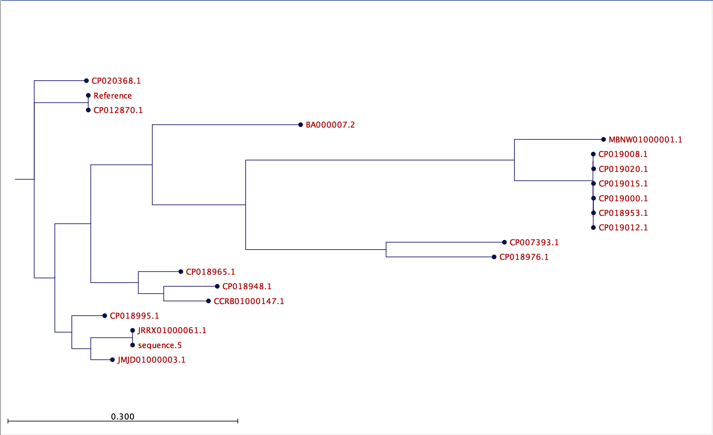
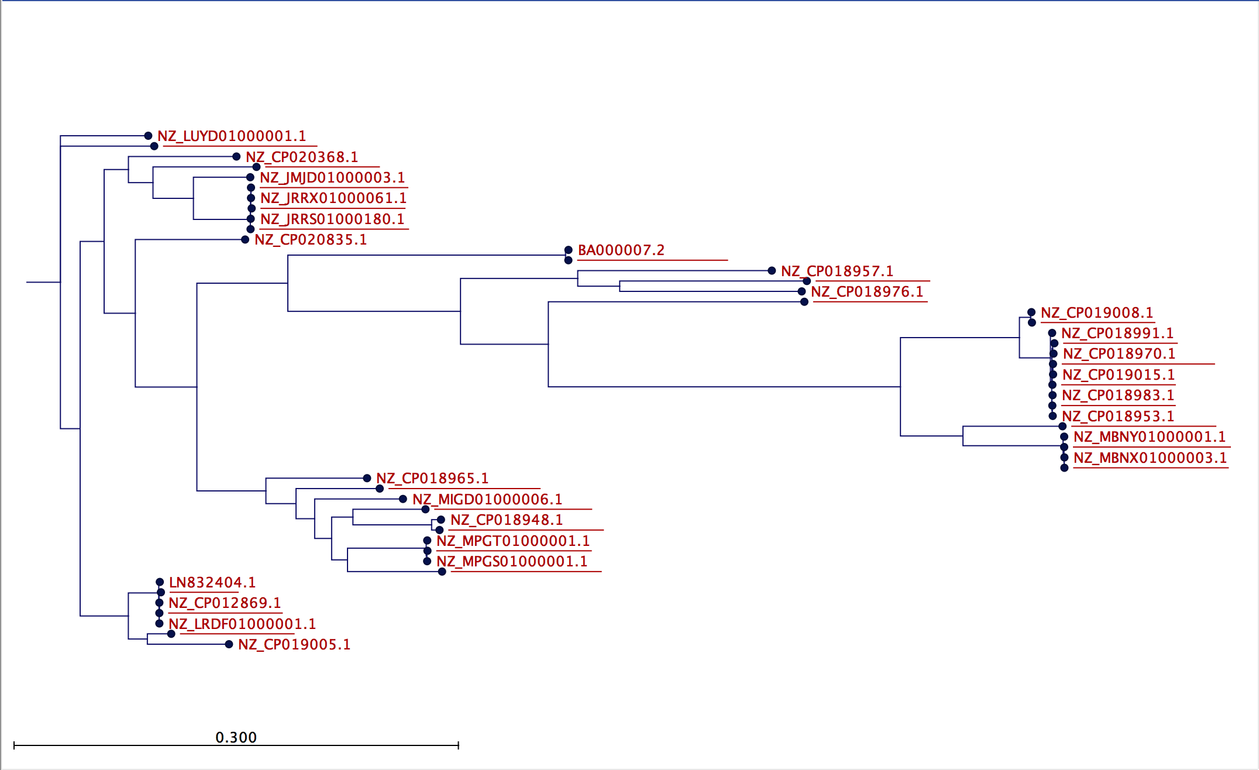
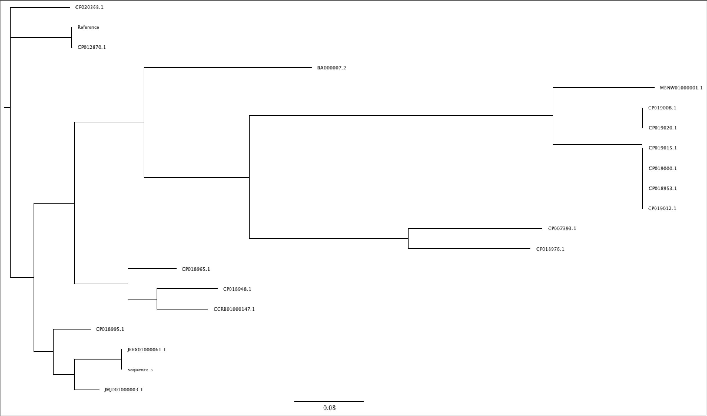
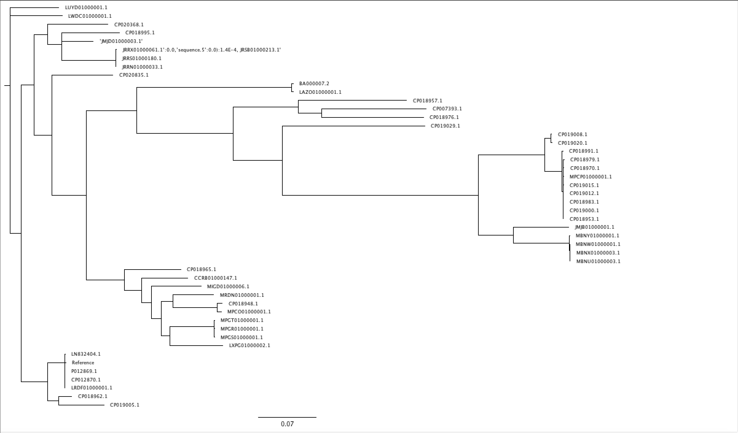
Analysis workflow for the evaluation of phylogenetic relationships among microbial genomes
Enrique Garcia-Assad, Indresh Singh, Pratap Venepally, Jason Inman
Abstract
Phylogenetic trees in Newick format
C
Whole genome sequencing (WGS) is increasingly utilized as an investigative tool of choice for analyzing samples in clinical microbiology. It allows rapid identification of strains that are present in the samples and facilitates the formulation of a targeted treatment of the affected subjects, especially in disease outbreak events. A major bottleneck in such an approach currently is the lack of an established methodology which can be used to rapidly process a large number of microbial genomes. To address this, as a demonstration, we have outlined in this presentation one analysis method using commonly available software (programs).
Run NASP
Background
Identification of microbial genomes in various environments and populations and understanding of their genetic relationship is critical in studies related to phylogeography, epidemiology, disease outbreaks and the development of diagnostic tools. In this presentation, we illustrate a method which is useful in such analyses involving large number of genomes assembled from high-throughput sequences. The analysis workflow uses NASP [1] in the first step to align the assembled Escherichia coli genomes obtained from Genbank to a reference for SNP identification. NASP can be used with multiple short-read aligners and SNP callers in addition to having the option of running it on the computer grid (network). In the second step, FastTree program [4] is used to cluster related genomes into a phylogenetic tree based on NASP output. Finally, the genotypic relationships among the input genomes are visualized by displaying them in graphical tree viewer programs FigTree [3] & CLC Workbench [2].
Run FastTree
(bestsnp/miss-ingdata fasta)
View tree in FigTree/CLC Workbench
Methods
Fig 1. The schematic workflow of the analysis.
D
The following analyses are performed in sequence.
A). Alignment of genomes & SNP identification (NASP analysis): Two sets of genome sequences were used in the analysis. A smaller set of 20 random E. coli genomes (19 experimental and 1 reference)* were initially processed on the JCVI's Univa computer grid to optimize the run parameters for the program (not shown). The larger, second group of 50 genomes from the same strain (49 experimental – including 19 samples from the initial set - and 1 reference)** were processed subsequently using the parameters identical to the first run. As shown schematically in Fig 1, the genomes used in this study (see footnotes* & **) were downloaded from Genbank in FASTA format and placed in a 'run' directory. The genome designated as the reference was separated from the query (experimental) sequences by moving it into a separate directory. To ensure there was enough memory for a successful completion of the analysis with large number of genomes, the processing was executed on the high-memory (500 GB) Unix server. The NASP analysis was performed in the 'run' directory using parameters described in NAS SOP on the JCVI internal confluence page (http://confluence.jcvi.org/display/VISW/NASP+SOP).
B). FastTree: The consensus SNP information generated by NASP in bestsnp.fasta (19 genomes) or missingdata.fasta (49 genomes) was used as input file to the FastTree program with default parameters to build phylogenetic trees (Fig 1).
C). Evaluation of Phylogenetic trees: The tree files in Newick format generated by FastTree are imported into either FigTree or CLC Workbench GUI for evaluation of the phylogenetic relationship among the genomes (Fig 2, A-D).
Results
A
Separate reference & query genomes into different directories
Fig 2. The maximum-likelihood phylogenetic trees generated by FastTree. A). The 19 genomes clustered using consensus bestsnp.fasta & viewed in FigTree, B). The 49 genomes clustered using consensus missingdata.fasta & viewed in FigTree, C & D). same as in A & B but viewed in CLC Workbench.
Obtain desired genomes
Conclusions
B
The goal of the analysis was to demonstrate that NASP can process large genomic data sets for a rapid identification of SNPs which subsequently can be used to evaluate phylogentic relationships among the related microbial samples. Our study example shows that NASP indeed satisfies that requirement. The observation that a smaller set of 19 closely related genomes (conserved bestsnp.fasta) retain the same phylogenetic clustering relationships even when analyzed as a subsample of a larger variant 49 genome group (missingdata.fasta) suggests that NASP is not only fast but also produces accurate results.
Acknowledgments
Log on to high-memory server
Garcia-Assad, Enrique, would like to thank JCVI for the opportunity to take part in the summer internship program. The training and the knowledge he gained will help him in his future academic career.
Move into ‘run’ folder
References
[1]. Sahl, J.W., Lemmer, D., Travis, J., Schupp, J.M., Gillece, J.D., Aziz, M., Kiem, P. (2016). NASP: an accurate, rapid method for the identification of SNPs in WGS datasets that supports flexible input and output formats.
[2]. CLC Workbench: https://www.qiagenbioinformatics.com/products/clc-genomics-workbench/
[3]. FigTree: http://tree.bio.ed.ac.uk/software/figtree/
[4]. Price, M.N., Dehal, P.S., Akrin, A.P. (2010). FastTree 2 – Approximately Maximum-Likelihood Trees for Large Alignments.
* 19 Genomes Sequence IDs: 1 NZ_CP018948.1, 2 NZ_CP018965.1, 3 NZ_CP012870.1, 4 NZ_JRRX01000061.1, 5 NZ_JRRX01000061.1, 6 NZ_CP018976.1, 7 NZ_JMJD01000003.1, 8 NZ_CP018995.1, 9 NZ_CP020368.1, 10 NZ_MBNW01000001.1, 11 NZ_CP007393.1, 12 NZ_CP019008.1, 13 NZ_CP019020.1, 14 NZ_CP019015.1, 15 NZ_CP019012.1, 16 NZ_CP019000.1, 17 NZ_CP018953.1, 18NZ_CCRB01000147.1, 19 BA000007.2
** 49 Genomes Sequence IDs:20 LN832404.1, 21 NZ_CP012869.1, 22 NZ_MPCO01000001.1, 23 NZ_JRRN01000033.1, 24 NZ_LXPG01000002.1, 25 NZ_MRDN01000001.1, 26 NZ_MPGR01000001.1, 27 NZ_MBNX01000003.1, 28 NZ_MBNU01000003.1, 29 NZ_CP019029.1, 30 NZ_CP018957.1, 31 NZ_CP018970.1, 32 NZ_MBNY01000001.1, 33 NZ_CP020835.1, 34 NZ_LUYD01000001.1, 35 NZ_JRSB01000213.1, 36 NZ_JMJB01000001.1, 37 NZ_CP018979.1, 38 NZ_CP018983.1, 39 NZ_MPGS01000001.1, 40 NZ_CP018962.1, 41 NZ_CP019005.1, 42 NZ_CP018991.1, 43 NZ_MPGT01000001.1, 44 NZ_LWDC01000001.1, 45 NZ_MIGD01000006.1, 46 NZ_LAZO01000001.1, 47 NZ_MPCP01000001.1, 48 NZ_JRRS01000180.1, 49 NZ_LRDF01000001.1 (first 19 same as 19 Genomes)

