Slide 1
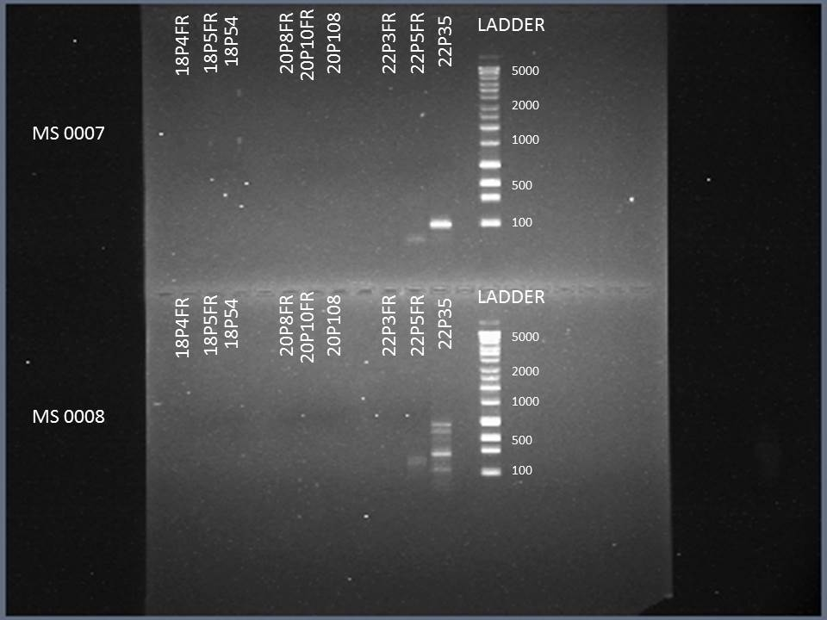
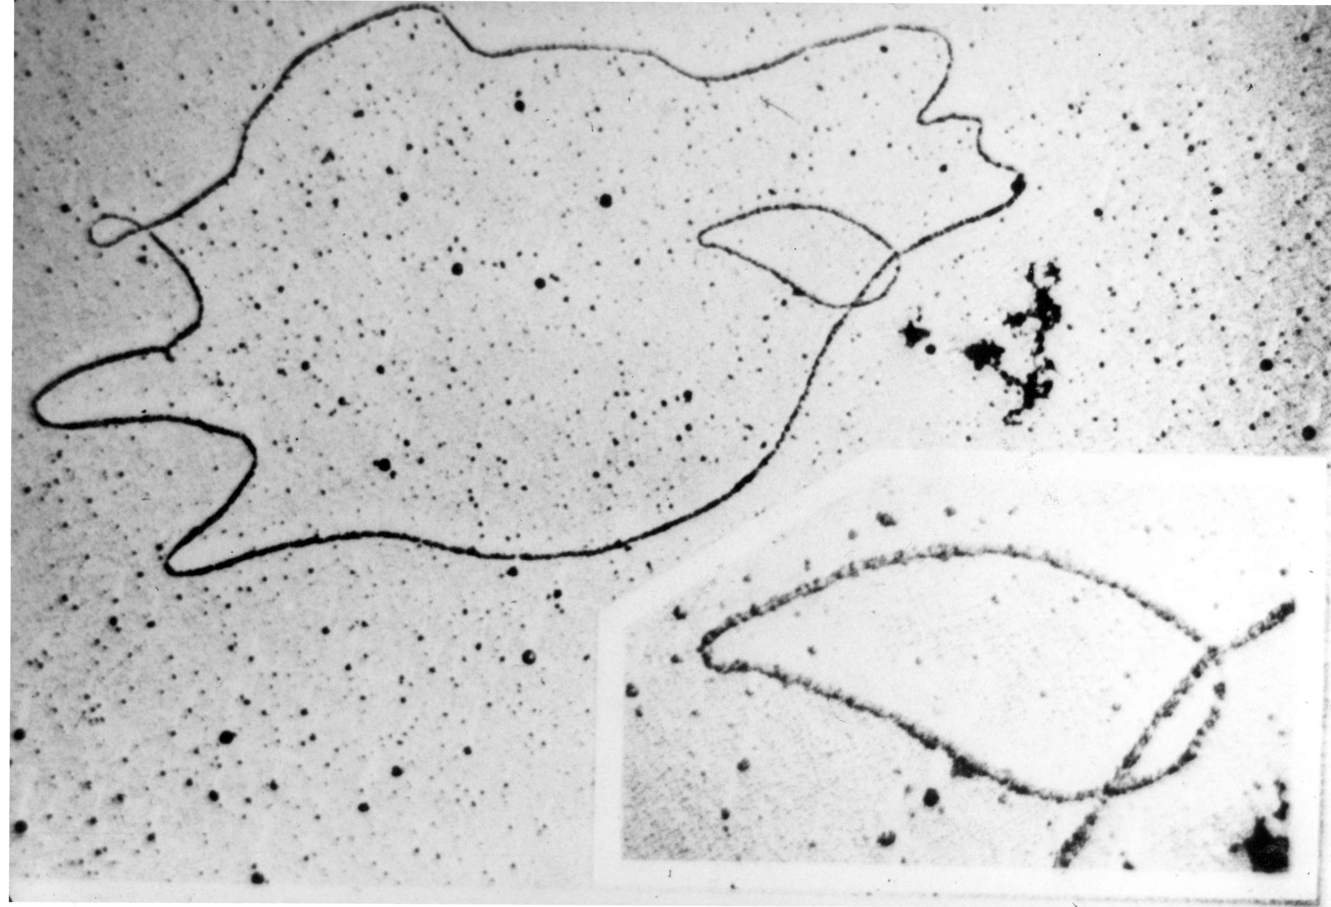
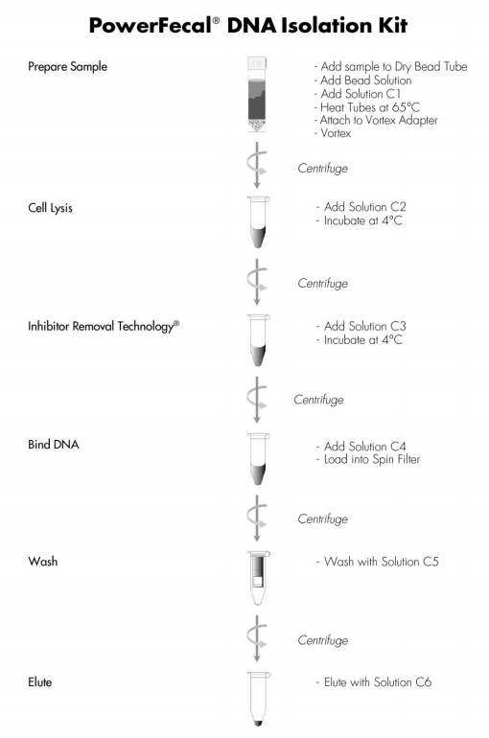
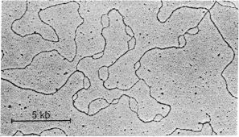
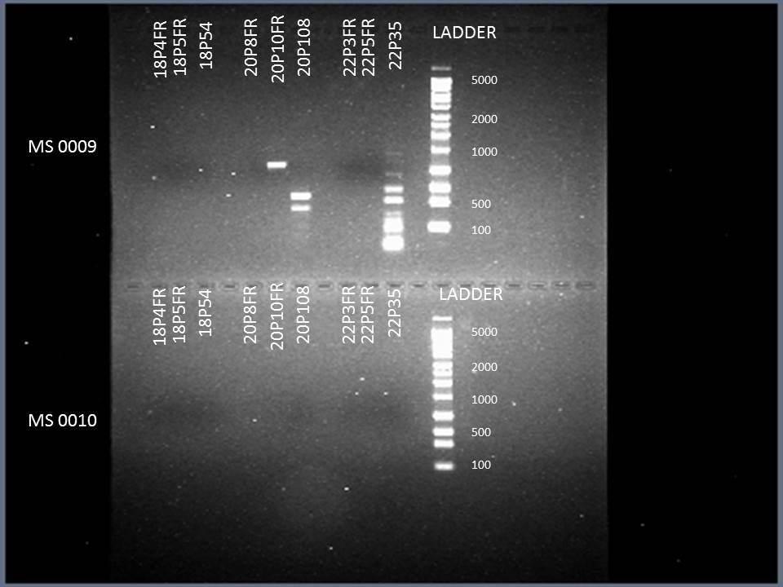
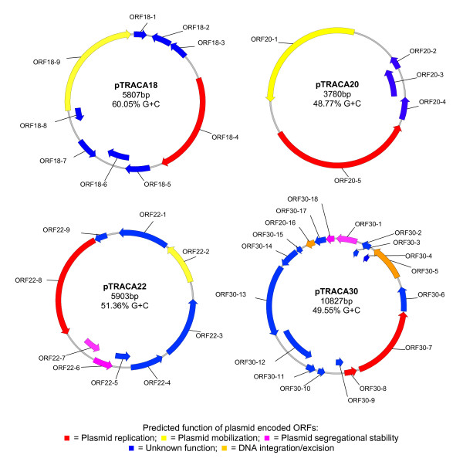
Identifying Bacterial Antibiotic Resistance Markers in gut microbes
Ian Lamb¹, Manolito Torralba²
J. Craig Venter Institute, San Diego, CA
BACKGROUND
MATERIALS
RESULTS
CONCLUSIONS
The gut microbiome is a large and mostly unknown mini-ecosystem which harbors symbiotic, commensal and pathogenic bacteria, along with fungi and viruses. Among bacteria, some have antibiotic resistance genes which they spread through conjugation with other bacteria. A Malian tribe was used for the study due to the fact that they have a more archaic diet and that plays a role in their gut microbiome.
Malian stool samples
PowerFecal ® DNA Isolation Kit
18P4F, 18P4R, 18P5F, 18P5R, 20P8F, 20P8R, 20P10F, 20P10R, 22P3F, 22P3R primers
2x Biomix Red
Thermocycler
1.2% agarose gels
Gel electrophoresis equipment
The PCR screening results of anti-microbial resistance plasmids vary per person due to each person having a different gut microbiome.
Emphasizes difference in microbiomes by individual
Antibiotic and antimicrobial genes are still present within individuals even with archaic diets
Some primer sets were too specific to land at location
Plasmids produce sporadic results due to difference in amount of plasmid content
ABSTRACT
METHODS
The gut microbiome plays a critical role in our health and well-being, but it also facilitates sharing of antibiotic resistance genes. However, antibiotic resistance genes can be identified by distinct markers which we screen in this study. Plasmids pTRACA18, pTRACA20, and pTRACA22 were chosen since they have demonstrated to be present in many gut microbes. This in turn allows the bacteria to spread antibiotic resistance genes to each other through conjugation and other forms of gene transfer. For the study, stool samples were used from a Malian tribe, which we extracted DNA from and screened for presence of plasmids through PCR. When the amplicons were screened, we determined that the amount of anti-microbial plasmids are sporadic because within each individual there are differing levels of abundance for each plasmid due to varying gut microbiomes.
Extract DNA from Malian stool samples using a PowerFecal ® DNA Isolation Kit
Create plasmid amplicons using 2μL of primers, 44μL of 2x Biomix Red, and 4μL of DNA
Run amplicons through 1.2% agarose gel
Simple screening using a Bio-Rad gel imager
Fig. 1
MS 0007 – Plamids 18 and 20 were not present, plasmid 22 was preseAnt, however not at length expected.
MS 0008 – Plamids 18 and 20 were not present, plasmid 22 was present, however at different lengths due to variation in plasmid content.
https://upload.wikimedia.org/wikipedia/commons/c/ca/DNA_Under_electron_microscope_Image_3576B-PH.jpg
http://www.pnas.org/content/71/1/135.full.pdf
REFERENCES
Brian V Jones, Funing Sun, Julian R Marchesi. 2010. Comparative metagenomic analysis of plasmid encoded functions in the human gut microbiome. BMC Genomics. 10.1186/1471-2164-11-46
https://mobio.com/media/wysiwyg/pdfs/protocols/12830.pdf
Reagents | μL
Primer Set | 2
2x Biomix Red | 44
Template DNA | 4
Fig. 2
MS 0009 – Plamid 18 was not present, plasmids 20 and 22 were present. 20P10FR was near expected length, Plasmid 22 not at expected length due to variation in plasmid content.
MS 0010 – No plasmids were present in this sample.
ACKNOWLEDGEMENTS
JCVI Internship Program
Department of Genomic Medicine
AMR Horizontal Gene Transfer Project
Comparative metagenomic analysis of plasmid encoded functions in the human gut microbiome
Brian V Jones, Funing Sun, Julian R Marchesi

